Slide 1
Expectation of nocebo hyperalgesia affects EEG alpha activity
- S. Albu, M. Meagher
Brain Cognitive Society, IIT-K
Debaditya Bhattacharya
May 2020

Slide 2

What is Nocebo Hyperalgesia?
Expectation of a negative outcome can lead to pain enhancement. This is known as Nocebo Hyperalgesia.
It is the opposite effect to the placebo effect, where we expect a positive outcome.
(https://www.earth.com/news/expecting-pain-hurt/)

Slide 3
Why do this study?
Pain is a complex sensory and emotional experience that can vary widely between people. Affect and psychological process such as expectancy and attention are important determinants of pain perception.
Nocebo hyperalgesia causes issues in clinical trials in patients with chronic pain.
Previous research suggests that EEG alpha power is linked to clinical and experimental pain, pain expectancy and hence, anticipatory anxiety and negative expectations.

Slide 4
Methods:
Participants 52 healthy college students.
It was a 2.5hr study. Random assignment into control and nocebo groups.
Participants introduced to sample of pain and asked to grade it on a scale of 100.
Cognitive manipulation was carried out by applying an inert cream to the region of stimulation and telling the control that “It has no effect on pain, it is to delimit the area”. And the nocebo group that “The cream increase pain perception”.

Slide 5
EEG DATA
Data was collected from 32 channels (10-20 system). Participants were asked to keep eyes closed & focus on the heat induced sensation. Intensity of pain was verbally reported.
Data imported into EEGLab Toolbox. 2s long epochs.
Filtering of data, rejected data corresponding to blinks and eye movement, or muscle twitching.
FFT was done on the epochs and absolute and relative powers were computed. In alpha-1, alpha-2, beta and gamma bands.

Slide 6
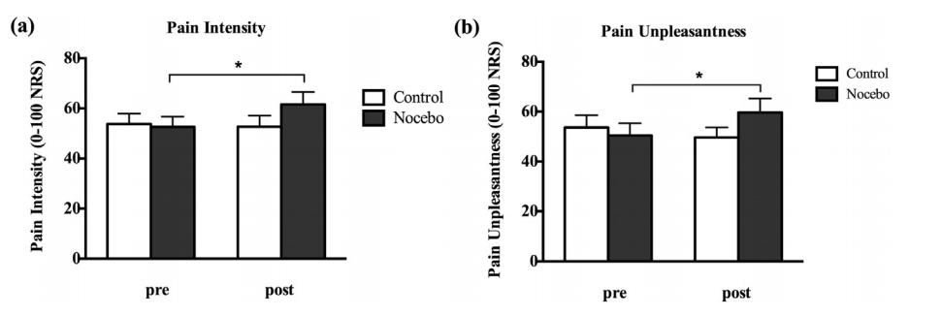
Results
The mean temperature that induced pain-60 was near 45C, clearly increased unpleasantness and pain intensity in the participating groups.

Slide 7
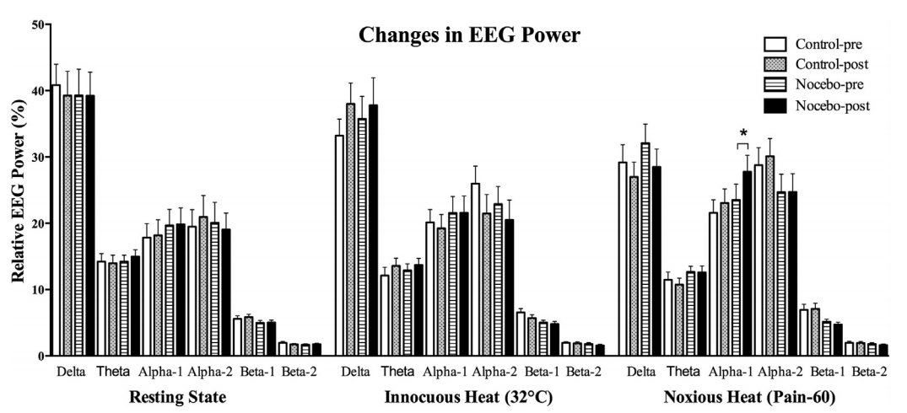

Slide 8
Discussion and conclusion
This experiment is the first study to examine changes in EEG activity associated with nocebo manipulation and their relationship with cognitive-affective responses to pain.
The modulation of alpha power does not reflect enhanced pain perception but rather expectancy-related changes in cognitive-affective states in a process parallel with pain facilitation by nocebo.

